Slide 1
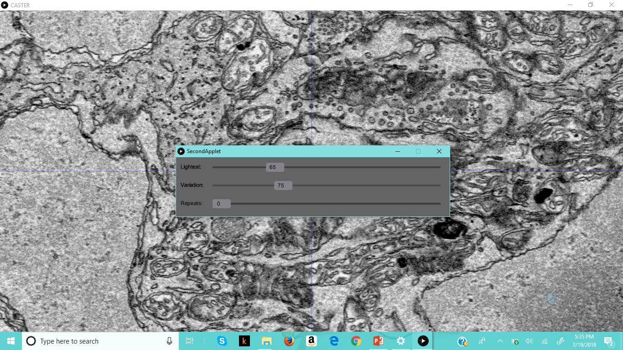
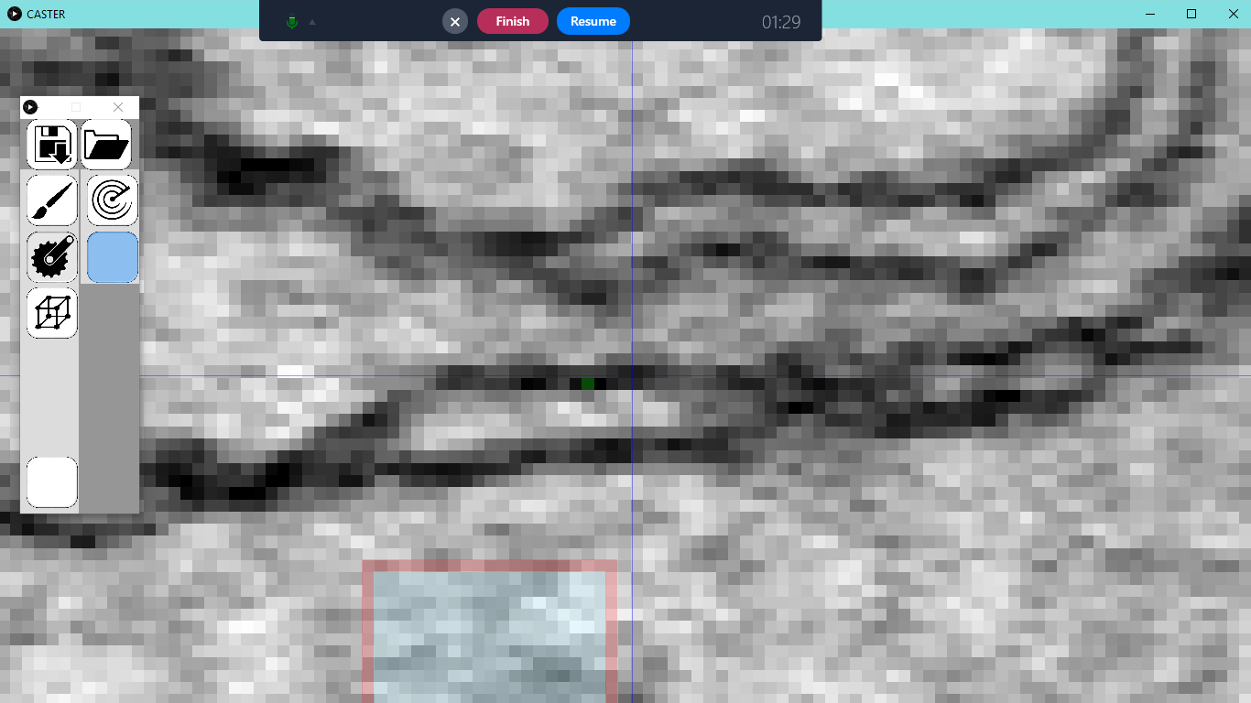
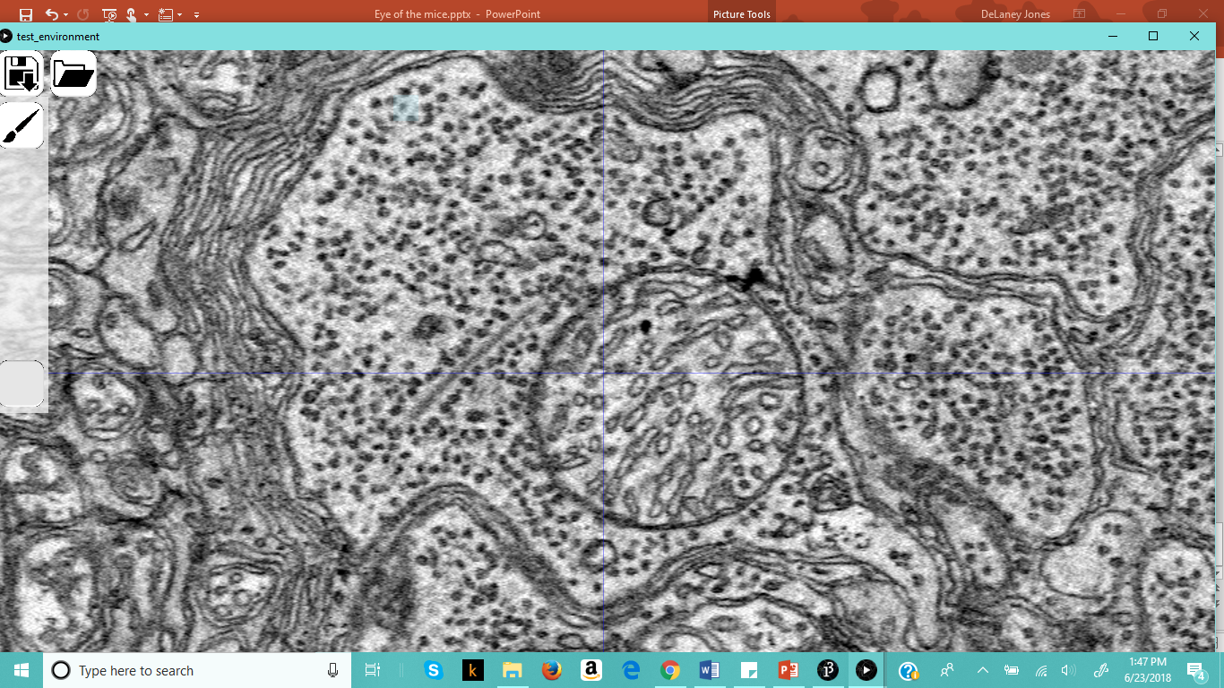
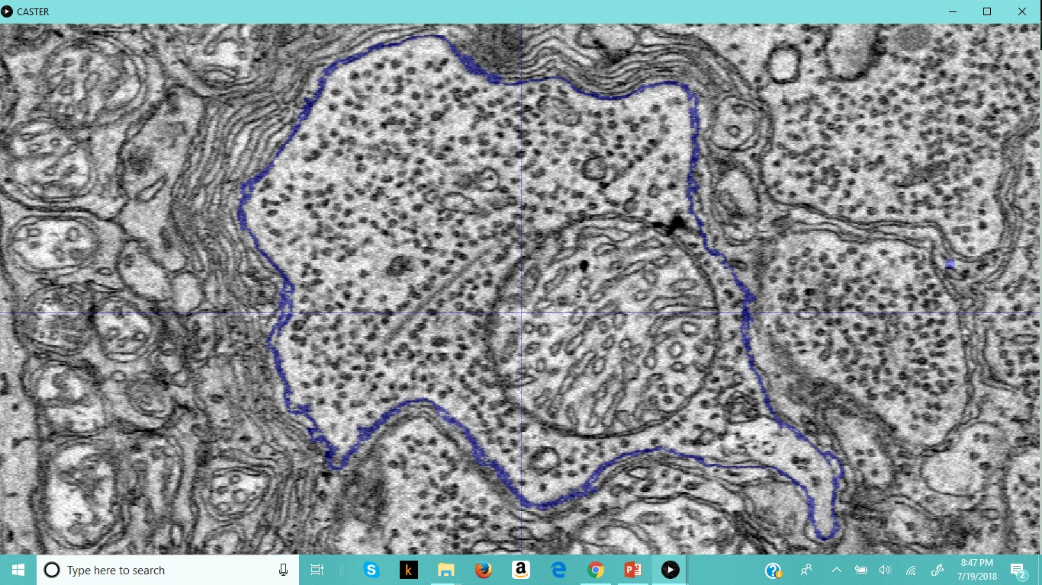
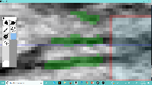
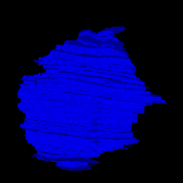
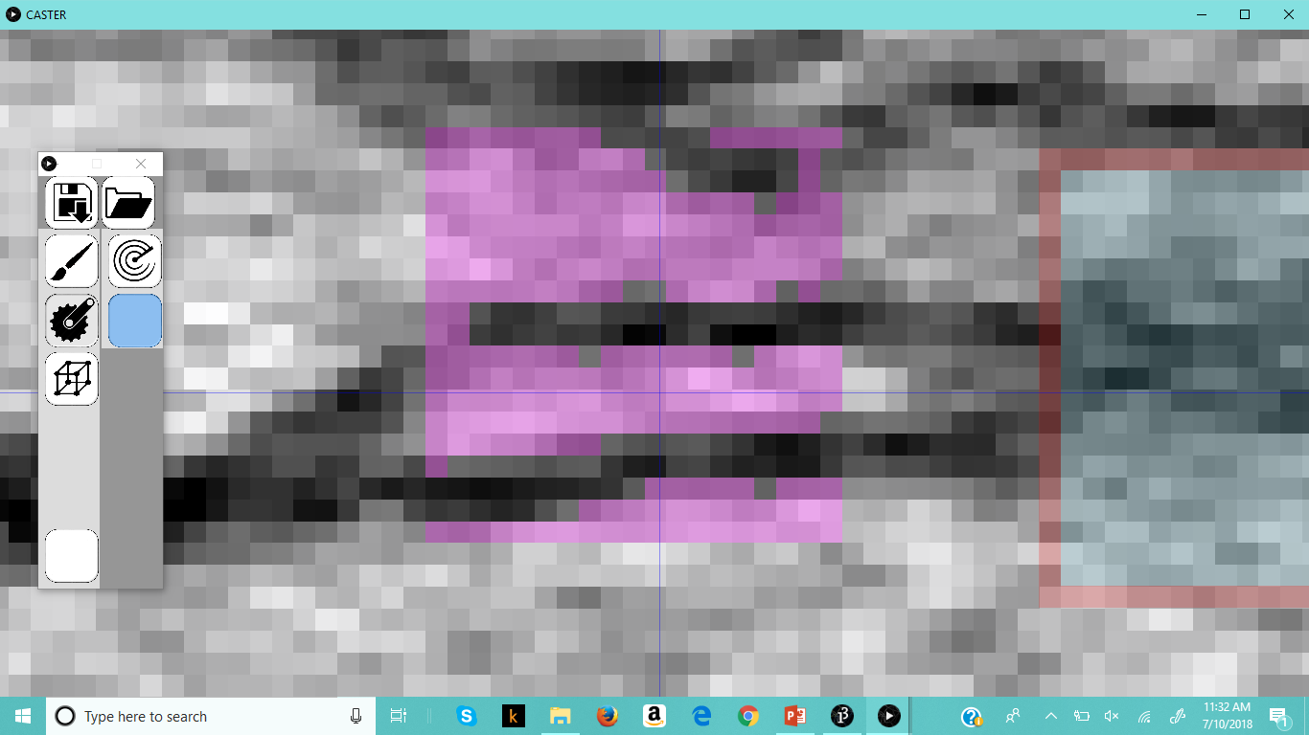
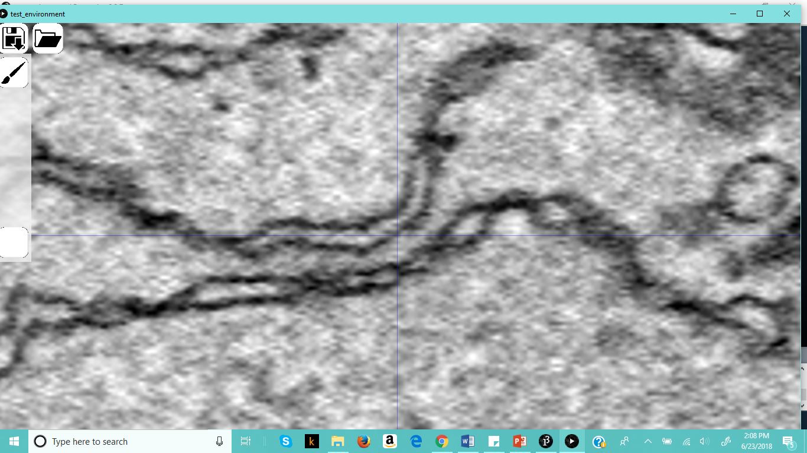
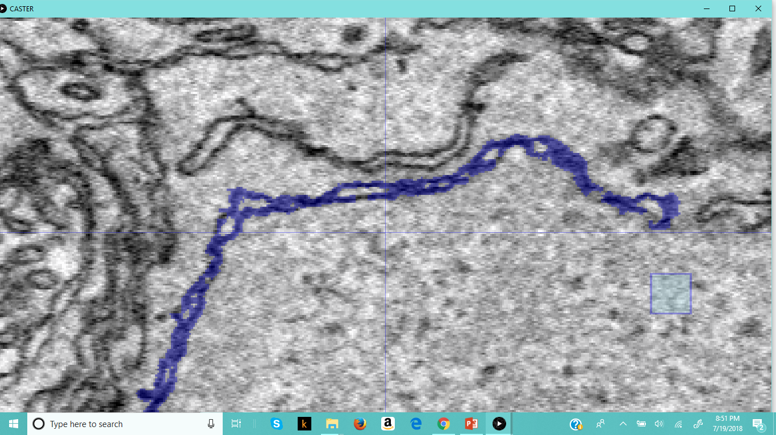
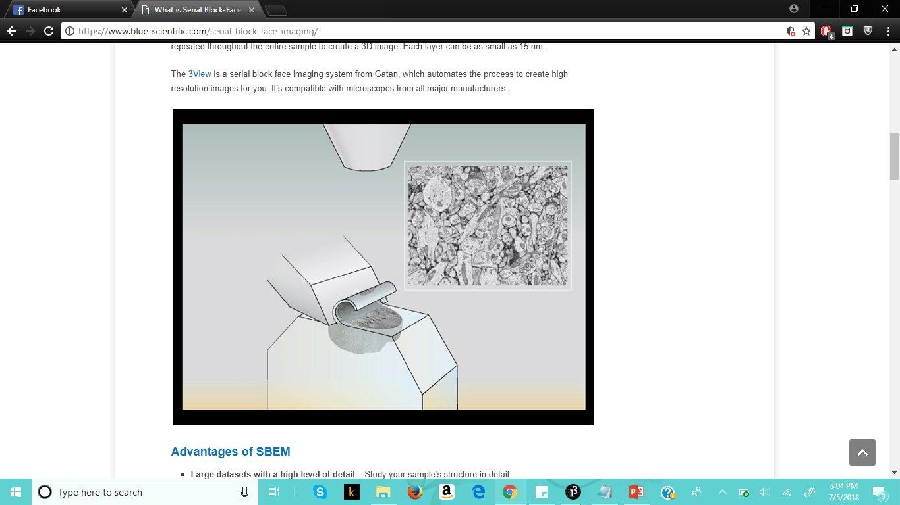


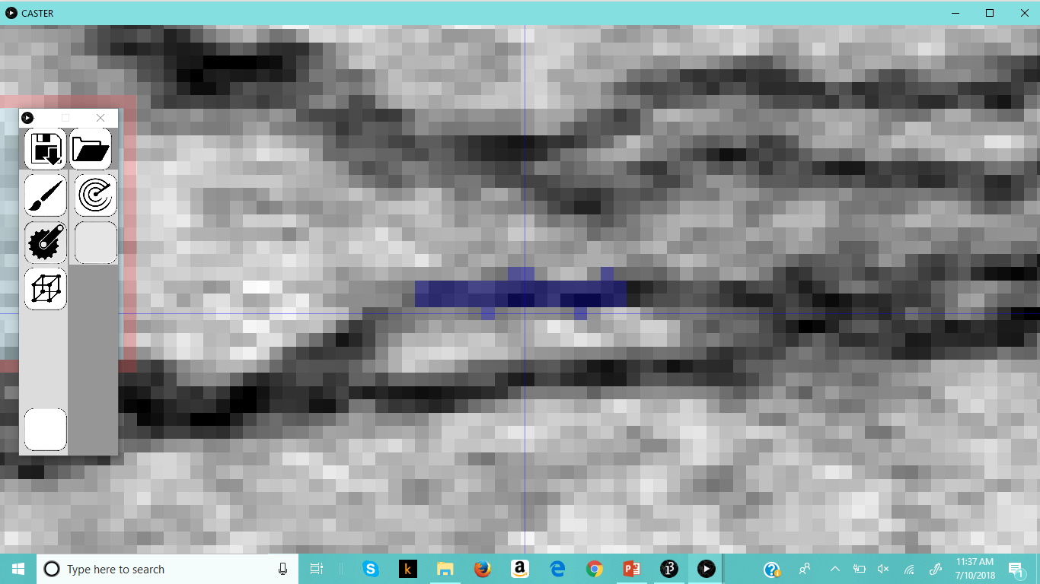
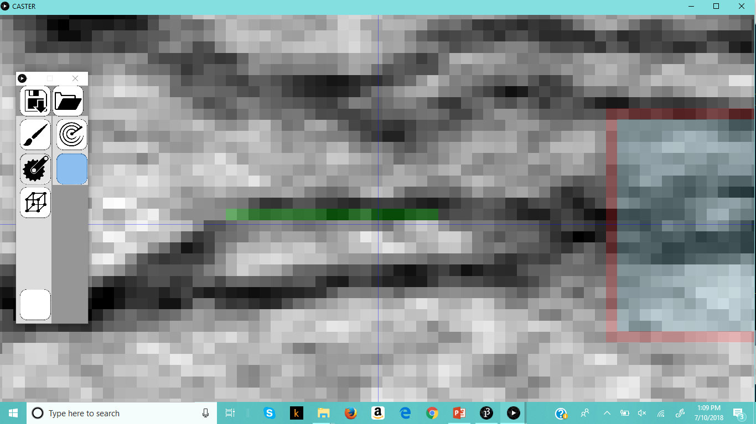
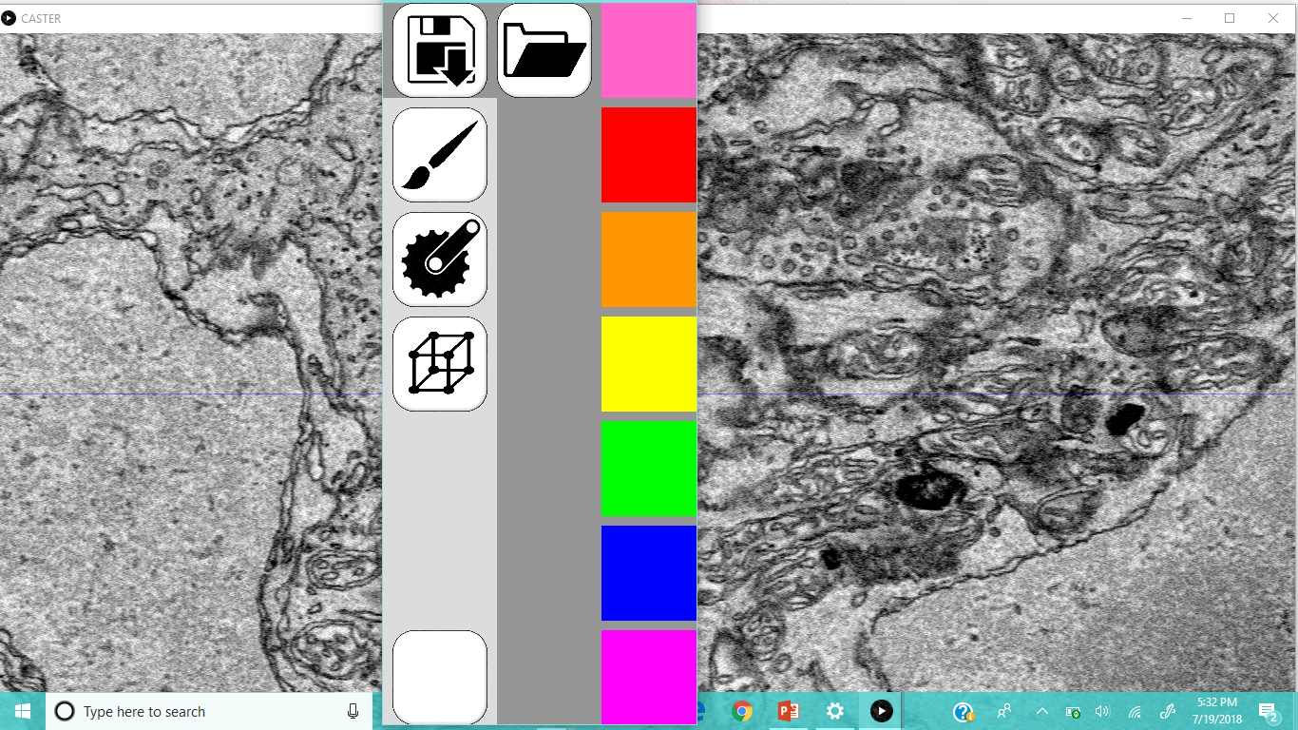
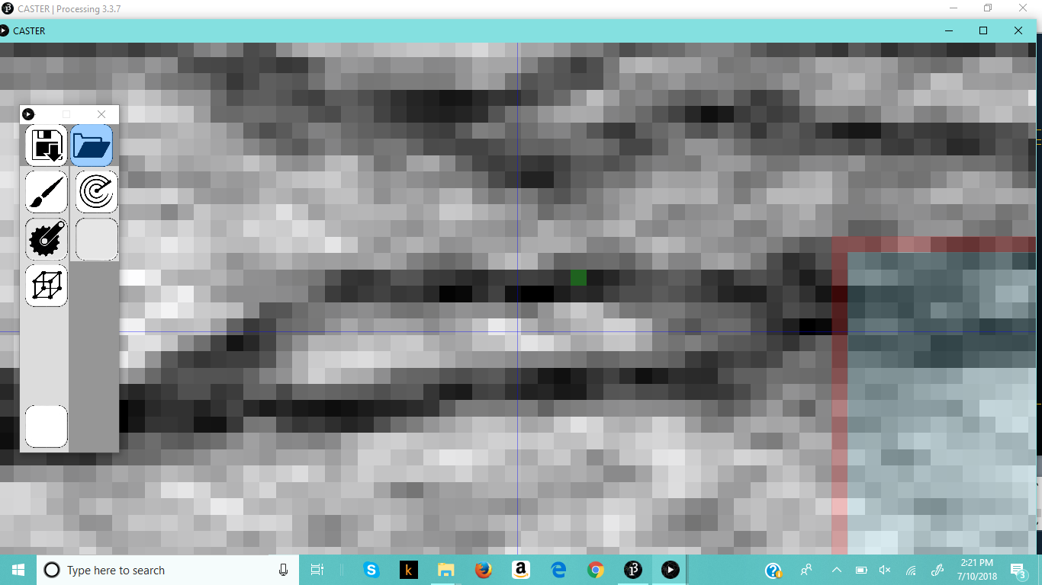



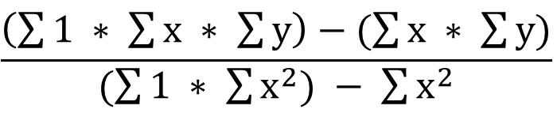
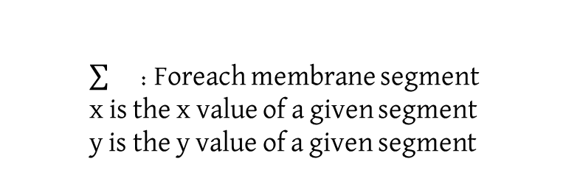
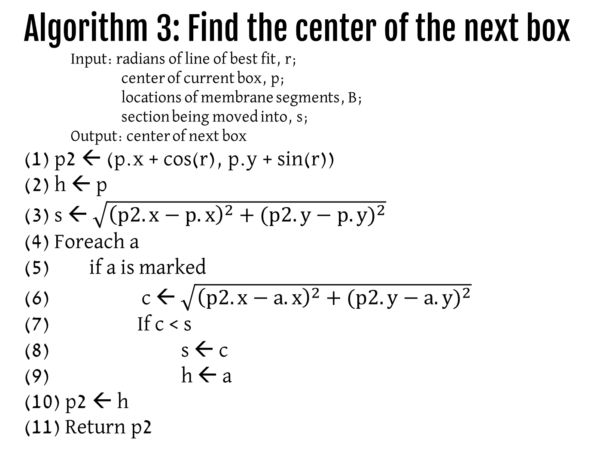
Eye of the Mouse: An Automated Membrane Outliner
DeLaney Jones, Jesse McDonald, Samuel Seth Long
Lewis-Clark State College
CASTER
As medical research advances, so does the demand for ways to discover and analyze new data. One area of biomedical research is to identify specific genes and the effects they have in the body. Once genes are better understood, scientists can discover better treatment options.
A big holdup on cellular analysis is how long it takes to identify structures and to see how they interact with what’s around them. CASTER is a program designed to speed up this process by automatically outlining membranes. This program uses contrast within the image and a line of best fit. From there, the user can display a 3D image to help analyze the data.
How does it work?
Results
The first way to use CASTER is to set the number of boxes made to zero, turning off the automatic membrane outlining. This is helpful in areas where the contrast is not well defined. As the user drags their mouse, the program selects the points in that area that are most likely part of the membrane.
CASTER
Obtain the darkest color
Use linear regression analysis to find the slope of the line of best fit
Match the slope to the section
Locate a pixel on known membrane in the direction of the new section
Select pixels that are within the range
Select all pixels that are not in the range
Flood fill starting from known membrane
1.3 micrometers
5.8 micrometers
For each section of the current area, a ϵ A
Algorithm 1: Find locations of membrane segments
Input: Locations of possible membrane segments, T;
Locations of non-membrane segments, W;
Lightest acceptable color, l;
Amount of color variation allowed, v;
Center of current box, p;
Darkest color in current box, m;
Output: locations of membrane segments
(1) W ← { }
(2) Foreach a ϵ A
(3) If a ∉ T
(4) Add a to W
(5) If a > (m + v)
(6) Add a to W
(7) R ← { }
(8) Add p to R
(9) While R ≠ { }
r ← Remove the first item from R
N ← neighbors of a ϵ T
(12) Foreach n ϵ N
If n is not marked, and n ∉ W
Add n to R
Mark n
(16) Return R
The second way is to set the number of boxes to anything else, and the program will highlight the well-defined membrane. The selected points are based on how the sliders were set. The user clicks on a single point on the membrane, and the program works outwards from there to select the membrane.
Methods
2.1 micrometers
The QR code to the right links to an example video of the methods being used, as well as a completed 3D view of a rod spherule.
(Warwick, 2018)
112.5°
6
67.5°
157.5°
2
1
22.5°
To get the image stack, a process known as Serial Block-Face Imaging was used. Above is an example of how this process works, and the image below shows the steps of this process. The QR code leads to a page where a video description of this process is available. Mice were used to obtain the biological samples.
7
5
337.5°
202.5°
3
4
Algorithm 2: Linear Regression Analysis
247.5°
8
292.5°
$$\frac{\left(\sum{1} ∗ \sum{x} ∗ \sum{y}\right)−(\sum{x} ∗ \sum{y})}{(\sum{1 ∗ \sum{x^{2}}) − \sum{x^{2}}}}$$
: Foreach membrane segment
x is the x value of a given segment
y is the y value of a given segment
The eye is perfused with resin
Then it’s sliced into 70 nanometer thick slices
An electron beam scans each slice and an image is created from the deflection of electrons
The images are loaded into a stack that are used to make 3D models
Algorithm 3: Find the center of the next box
Input: radians of line of best fit, r;
center of current box, p;
locations of membrane segments, B;
section being moved into, s;
Output: center of next box
(1) p2 ← (p.x + cos(r), p.y + sin(r))
(2) h ← p
(3) s ← $\sqrt{{\left(p2.x−p.x\right)}^{2}+({p2.y−p.y)}^{2}}$
(4) Foreach a
(5) if a is marked
(6) c ← $\sqrt{{\left(p2.x−a.x\right)}^{2}+({p2.y−a.y)}^{2}}$
(7) If c < s
(8) s ← c
(9) h ← a
(10) p2 ← h
(11) Return p2
5
This publication was made possible by an Institutional Development Award (IDeA) from the National Institute of General Medical Sciences of the National Institutes of Health under Grant #P20GM103408, the LCSC HERC-STEM (Higher Education Research Council-Science Technology Engineering and Research award), and Lewis-Clark State College. I’d also like to acknowledge Dr. Samuel (Seth) Long, Jesse McDonald, and Dr. Peter Fuerst.
Warwick, T. (2018). What is Serial Block-Face Imaging? (SBEM) | Blue Scientific. [online] Blue Scientific. Available at: https://www.blue-scientific.com/serial-block-face-imaging/ [Accessed 5 Jul. 2018].

